Slide 1
Adult Income
Presentation
Analysis from Income Prediction with Census Data by Geoffrey

Slide 2
Target Feature is Income
Age
Workclass
Final Weight (fnlwgt)
Education
Educational-Num
Marital-Status
Occupation
Relationship
Race
Gender
Capital-Gain
Capital-Loss
Hours per week
Native Country

Slide 3
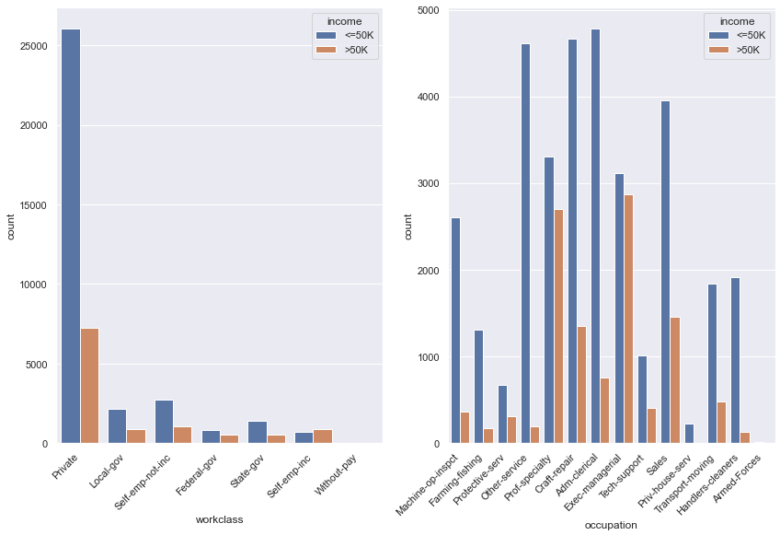

Slide 4
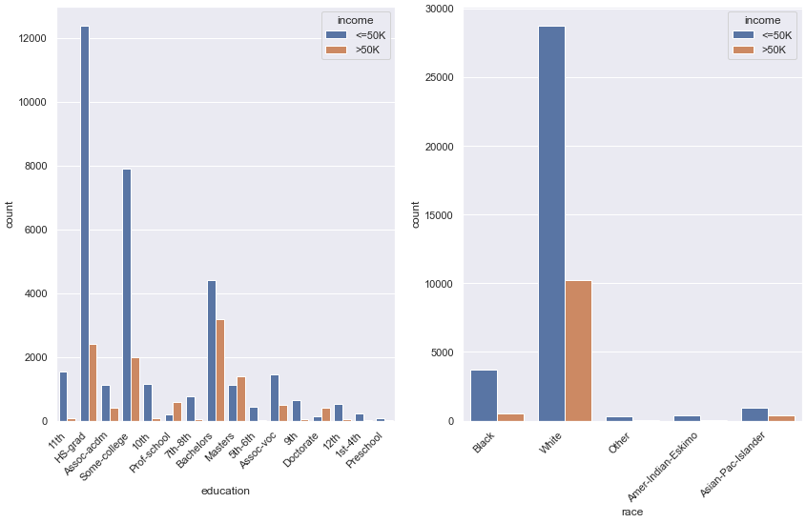

Slide 5
Training The Models
Decision Tree
Naive Bayes
K-Nearest Neighbor
Linear Regression

Slide 6
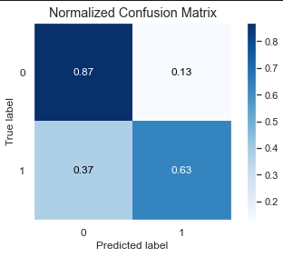
81.06%
Accuracy score of Decision Tree

Slide 7
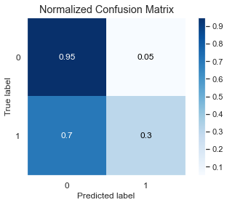
78.74%
Accuracy score of Naive Bayes

Slide 8

76.44%
Accuracy score of K-Nearest Neighbor

Slide 9
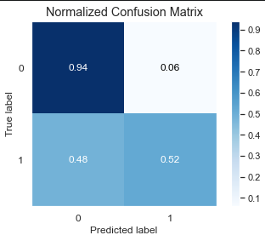
83.50%
Accuracy score of Linear Regression

Slide 10
TensorFlow Model
Layer (type) | Output Shape | Param #
flatten_1 (Flatten) | (None, 104) | 0
dense_3 (Dense) | (None, 52) | 5460
dense_4 (Dense) | (None, 22) | 1160
dense_5 (Dense) | (None, 2) | 46
Total params: 6,672
Trainable params: 6,672
Non-trainable params: 0

Slide 11
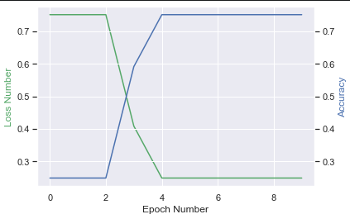
75.41%
Accuracy score of TensorFlow Model

Slide 12
Summary
Model | Decision Tree | Naive Bayes | KNN | Linear Regression | TensorFlow
Accuracy % | 81.06 | 78.74 | 76.44 | 83.50 | 75.41

